Slide 1
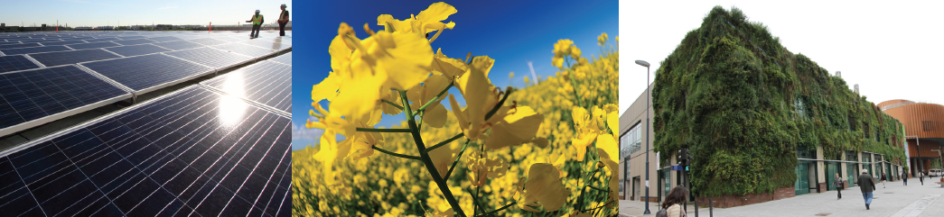
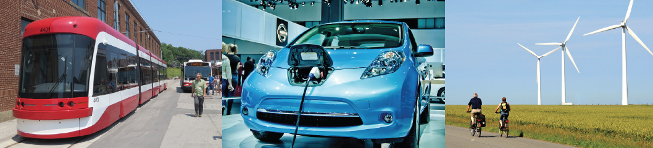

T
Reducing GHG Emissions in Canada: A Formidable Challenge
Trottier Energy Futures Project Results
Presented by Dr. John Leggat
5 April 2016

Slide 2
Background
IPCC – “There are multiple pathways to… significantly reducing GHG emissions”
Canadian situation presents unique challenges and opportunities
TEFP – Study sponsored by CAE and DSF. Funding from Trottier Family Foundation
Rigorous and comprehensive engineering analysis
Results suggest pathways and enablers; not solutions
Stimulate informed discussion

Slide 3
A Significant Undertaking
Goal of 80% reduction in GHG emissions by 2050 compared to 1990 levels – 118Mt
Options and pathways for reducing GHG emissions by more than 100% by 2100
Combustion and non-combustion emissions
Alternate Futures analysis
Medium Term (2030) – promising pathways
Long Term (2050) – hard problems

Slide 4
Emissions - Mt
Year | Total | Combustion | Non-Combustion
TARGET | 118
1990 - actual | 591 | 427 | 164
2010 - actual | 692 | 498 | 194

Slide 5
Approach to the Analysis
NATEM Model –
Linear programming optimization model
Primary drivers are end-use demands
Long-term horizon (50-100 years)
GHG emission targets
CanESS Model –
Simulation model
Primary drivers are demographic and macro-economic dynamics
All scenarios executed in 1-year steps
Tracks GHG emissions at the sources

Slide 6
Approach to Analysis
Alternate Futures Scenarios
8
8a
5
Technology Change
3
3a
4
1
Behavioural/Social Change

Slide 7
1990 Emissions
591 Mt

Slide 8
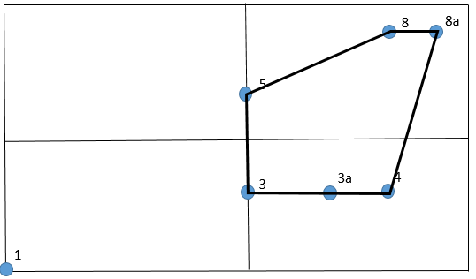
Energy Utilization
Other Hydrogen Biomass Electricity Fossil Fuel

Slide 9
Reference Scenario 1 – Present Policies
1109 Mt in 2050

Slide 10
Scenario 8a – 60% Target
394 Mt in 2050

Slide 11
Combustion Emission Reductions
Scenario 8a (70% reduction – 128 Mt)
Fossil fuel production

Slide 12
Emissions - Mt
Year | Total | Combustion | Non-Combustion
TARGET | 118
1990 - actual | 591 | 427 | 164
2010 - actual | 692 | 498 | 194
2050 - no change | 1109 | 755 | 354
2050 – 60% | 394 | 171 | 223
2050 – 70% | 351 | 128 | 223

Slide 13
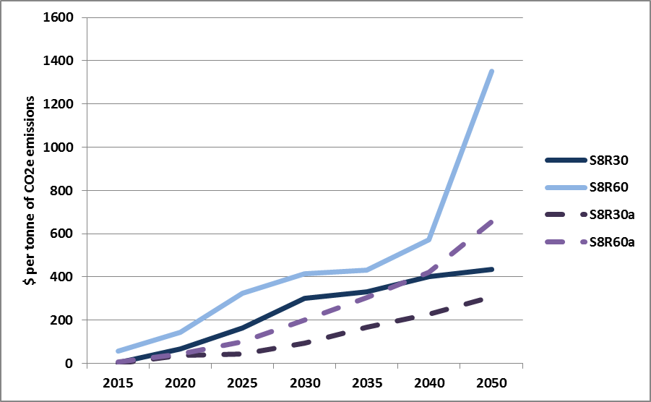
Cost per Tonne of CO2 Reduction

Slide 14
Principal Observations
Reduction pathways result in major end use changes
Largest reduction is 70% for combustion emissions
Non-combustion emissions need attention
Infrastructure availability projections are optimistic
Challenge to achieve 80% reduction by 2050
Net negative emissions required before 2050
Immediate priorities are clear; longer term path requires more investigation and research

Slide 15
Promising Pathways
Absolute importance of carbon free electricity
Best sources of electricity are hydro, nuclear and wind
Interjurisdictional transfers of electricity and access to storage are important
Considerable infrastructure investment is needed quickly
Reduced dependency on fossil fuels means lifestyle changes

Slide 16
Hard Problems
  Heavy road and rail transportation
  Insufficient feedstock to meet demand for biofuels
  Process changes for oil and natural gas are needed
  Changing urban form and behaviour – how will it be done in a North American context?
  Non-combustion emissions
  Net negative emissions
  Very fast build of large infrastructure required.

Slide 17
Immediate Priorities
Energy conservation / energy efficiency
Electrification of end uses
Decarbonizing electricity supply
Major growth and changes to electricity supply system
Research and development for hard problems

Slide 18
Opportunities
Low cost and carbon-free electricity - industrial production and export
Export of dependable capacity and electricity to U.S. and provision of storage
Expansion of forestry and agricultural sectors for production of biomass / biofuels
Carbon retention in wood products
Changes in petroleum sector for reduced emissions
Environmental and societal equilibrium

Slide 19
Contributions from
The Trottier Energy Futures Project
Provides perspectives on different pathways for deep GHG reductions
Demonstrates scale and complexity of the challenge
Defines where to start
Highlights hard problems
Identifies opportunities for immediate action
Shows merits of analytical approaches and need for sustaining and growing these capabilities

Slide 20

The full report
and executive summary
are available at:
http://iet.polymtl.ca/tefp
We welcome your comments:
iet@polymtl.ca

